Slide 1
Algorithms: Analysis
For: CSCI 163A / COEN 179
By: Navid Shaghaghi

Slide 2
Analysis
Analysis: “The separation of an intellectual or substantial whole into its constituent parts for individual study.” - American Heritage Dictionary
Analysis of algorithms: An investigation of an algorithm’s efficiency with respect to two resources: running time and memory space.

Slide 3
The Analysis Framework
Time efficiency (time complexity) indicates how fast an algorithm in question runs.
Space efficiency (space complexity) refers to the amount of memory units required by the algorithm in addition to the space needed for its input and output.
In the early days of electronic computing, both resources—time and space—were at a premium. But now the amount of extra space required by an algorithm is typically not of as much concern, with the caveat that there is still, of course, a difference between cache, fast main memory, and slow(er) secondary memory.

Slide 4
Measuring an Input’s Size
Almost all algorithms run longer on larger inputs.
For Example, it takes longer to sort larger arrays, multiply larger matrices, and so on.
Therefore, it is logical to investigate an algorithm’s efficiency as a function of some parameter n indicating the algorithm’s input size.
For Example, it will be the size of the list for problems of sorting, searching, finding the list’s smallest element, and most other problems dealing with lists.
For the problem of evaluating a polynomial p(x) = a_{n}x^{n} + . . . + a₀ of degree n, it will be the polynomial’s degree or the number of its coefficients, which is larger by 1 than its degree.

Slide 5
Measuring an Input’s Size
There are situations, of course, where the choice of a parameter indicating an input size does matter.
Example: computing the product of two n × n matrices. There are two natural measures of size for this problem.
the matrix order n (more frequently used)
the total number of elements N in the matrices being multiplied. (more general since it is applicable to matrices that are not necessarily square.)
Since there is a simple formula relating these two measures, we can easily switch from one to the other, but the answer about an algorithm’s efficiency will be qualitatively different depending on which of these two measures we use

Slide 6
Measuring an Input’s Size
The choice of an appropriate size metric can be influenced by operations of the algorithm in question.
For example, how should we measure an input’s size for a spell-checking algorithm?
If the algorithm examines individual characters of its input, we should measure the size by the number of characters;
if it works by processing words, we should count their number in the input.

Slide 7
Measuring an Input’s Size
How about measuring the input size for algorithms solving problems such as checking primality of a positive integer n?
Here the input is just one number, and it is this number’s magnitude that determines the input size.
In such situations, it is preferable to measure size by the number b of bits in the n’s binary representation: b = ⌊log₂ n⌋ + 1.

Slide 8
Units for measuring Running Time
Simply use some standard unit of time measurement—a second, or millisecond, and so on—to measure the running time of a program implementing the algorithm.
Drawbacks:
dependence on the speed of a particular computer,
dependence on the quality of a program implementing the algorithm and of the compiler used in generating the machine code, and
the difficulty of clocking the actual running time of the program.

Slide 9
Units for measuring Running Time
Counting the number of times each of the algorithm’s operations is executed.
Drawbacks:
excessively difficult
usually unnecessary

Slide 10
Units for measuring Running Time
Identifying the basic operation, the operation contributing the most to the total running time, of the algorithm and computing the number of times the basic operation is executed.
It is usually the most time-consuming operation in the algorithm’s innermost loop. For example:
Most sorting algorithms work by comparing elements (keys) of a list being sorted with each other; for such algorithms, the basic operation is a key comparison.
Algorithms for mathematical problems typically involve some or all of the four arithmetical operations: addition, subtraction, multiplication, and division. Of the four, the most time-consuming operation is division, followed by multiplication and then addition and subtraction, with the last two usually considered together.

Slide 11
Framework for the analysis of an algorithm’s time efficiency
Counting the number of times the algorithm’s basic operation is executed on inputs of size n.
Let c_{op} be the execution time of an algorithm’s basic operation on a particular computer, and let C(n) be the number of times this operation needs to be executed for this algorithm. T the running time T (n) of a program implementing this algorithm on that computer by the formula: T(n) ≈ c_{op}C(n).

Slide 12
Framework for the analysis of an algorithm’s time efficiency
Notes of caution:
The count C(n) does not contain any information about operations that are not basic, and, in fact, the count itself is often computed only approximately.
Further, the constant c_{op} is also an approximation whose reliability is not always easy to assess. Still, unless n is extremely large or very small, the formula can give a reasonable estimate of the algorithm’s running time.

Slide 13
Framework for the analysis of an algorithm’s time efficiency
It also makes it possible to answer such questions as
“How much faster would this algorithm run on a machine that is 10 times faster than the one we have?” The answer is, obviously, 10 times.
Assuming that C(n) = (½)n(n − 1), how much longer will the algorithm run if we double its input 2 size? The answer is about four times longer. Indeed, for all but very small values of n,

Slide 14
Order of Growth
Note that we were able to answer the last question without actually knowing the value of c_{op}: it was neatly cancelled out in the ratio.
Also note that 1/2 , the multiplicative constant in the formula for the count C(n), was also cancelled out.
It is for these reasons that the efficiency analysis framework ignores multiplicative constants and concentrates on the count’s order of growth to within a constant multiple for large-size inputs.

Slide 15
Order of Growth

Slide 16
Note about Logarithmic Analysis
Although specific values of such a count depend, of course, on the logarithm’s base, the formula: log_{a}n = log_{a}b * log_{b}n makes it possible to switch from one base to another, leaving the count logarithmic but with a new multiplicative constant. This is why we omit a logarithm’s base and write simply log n in situations where we are interested just in a function’s order of growth to within a multiplicative constant.

Slide 17
Note about Exponential-Growth
For example it would take about 4 * 10¹⁰ years for a computer making a trillion (10¹²) operations per second to execute 2¹⁰⁰ operations. Though this is incomparably faster than it would have taken to execute 100! operations, it is still longer than 4.5 billion (4.5 * 10⁹) years— the estimated age of the planet Earth.
There is a tremendous difference between the orders of growth of the functions 2^{n} and n!, yet both are often referred to as “exponential-growth functions” (or simply “exponential”) despite the fact that, strictly speaking, only the former should be referred to as such.
Algorithms that require an exponential number of operations are practical for solving only problems of very small sizes

Slide 18
Growth reaction to twofold increase in value
The function log₂n increases in value by just 1 (because log₂2n = log₂2 + log₂n = 1 + log₂n); the linear function increases twofold, the linearithmic function nlog₂n increases slightly more than twofold; the quadratic function n² and cubic function n³ increase fourfold and eightfold, respectively (because (2n)² = 4n² and (2n)³ = 8n³); the value of 2^{n} gets squared (because 2^{2n} = (2^{n})²); and n! increases much more than that (yes, even mathematics refuses to cooperate to give a neat answer for n!)

Slide 19
Efficiencies
Worst-Case efficiency: efficiency for the worst-case input of size n, which is an input (or inputs) of size n for which the algorithm runs the longest among all possible inputs of that size.
Best-Case efficiency: efficiency for the best-case input of size n, which is an input (or inputs) of size n for which the algorithm runs the fastest among all possible inputs of that size.
Average-Case efficiency: algorithm’s behavior on a “typical” or “random” input.
Amortized efficiency: applies not to a single run of an algorithm but rather to a sequence of operations performed on the same data structure.

Slide 20
Notes on Average-Case Efficiency
Investigation of the average-case efficiency is considerably more difficult than investigation of the worst-case and best-case efficiencies.
NOT the average of worst and best case.
Direct approach:
divide all instances of size n into several classes so that for each instance of the class the number of times the algorithm’s basic operation is executed is the same.
obtain or assume a probability distribution of inputs so that the expected value of the basic operation’s count can be found.

Slide 21
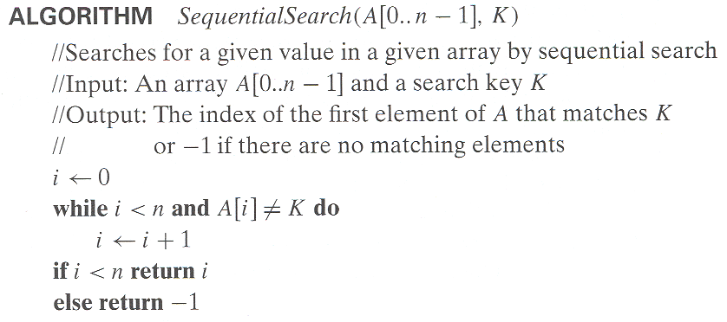
Example: What are the Worst, Best, and Average efficiencies of this algorithm?

Slide 22
Calculation of Average-Case Efficiency
Example: Serial Search
Assumptions:
the probability of a successful search is equal to p (0 ≤ p ≤ 1)
the probability of the first match occurring in the ith position of the list is the same for every i.
In the case of a successful search, the probability of the first match occurring in the i^{th} position of the list is p/n for every i, and the number of comparisons made by the algorithm in such a situation is obviously i.
In the case of an unsuccessful search, the number of comparisons will be n with the probability of such a search being (1 − p). T

Slide 23
Calculation of Average-Case Efficiency

Slide 24
Asymptotic Notation for Order of Growth
Order of growth of an algorithm is a way of analyzing how the execution time of a program (and/or the memory occupied by it) changes with the input size.
Notations:
O(n)
Θ(n)
Ω(n)

Slide 25
O-notation
Informal definition:
O(g(n)): class of functions f(n) that grow no faster than g(n)
Formal definition:
A function t(n) is said to be in O(g(n)), denoted t(n) ∈ O(g(n)), if t(n) is bounded above by some constant multiple of g(n) for all large n, i.e.,
if there exist some positive constant c and some nonnegative integer n₀ such that:
t(n) ≤ cg(n) for all n ≥ n₀.

Slide 26
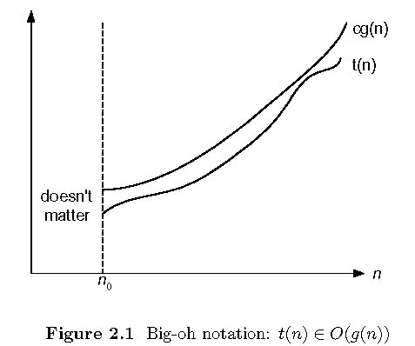

Slide 27
Example
100n + 5 ∈ O(n²)
100n + 5 ≤ 100n + n (for all n ≥ 5) = 101n.
So, c = 101 and n₀ = 5
t(n) ≤ cg(n) for all n ≥ n₀ ➔ 101n ≤ 101n² for all n > 5

Slide 28
Ω-notation
Informal definition:
Ω(g(n)): class of functions f(n) that grow at least as fast as g(n)
Formal definition:
A function t(n) is said to be in Ω(g(n)), denoted t(n) ∈ Ω(g(n)), if t(n) is bounded below by some positive constant multiple of g(n) for all large n, i.e.,
if there exist some positive constant c and some nonnegative integer n₀ such that:
t(n) ≥ cg(n) for all n ≥ n₀.

Slide 29
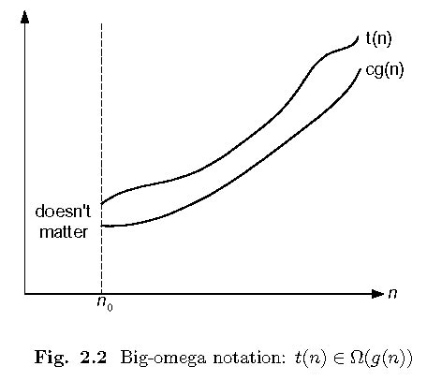

Slide 30
Example
n³ ∈ Ω (n²):
n³ ≥ n² for all n ≥ 0,
So c = 1 and n₀ =0.
t(n) ≥ cg(n) for all n ≥ n₀ ➔ n³ ≥ n² for all n > 0

Slide 31
Θ-notation
Informal definition:
Θ(g(n)): class of functions f(n) that grow at same rate as g(n)
Formal definition:
A function t (n) is said to be in Θ(g(n)), denoted t (n) ∈ Θ(g(n)), if t(n) is bounded both above and below by some positive constant multiples of g(n) for all large n, i.e.,
if there exist some positive constants c₁ and c₂ and some nonnegative integer n₀ such that:
c₂g(n) ≤ t(n) ≤ c₁g(n) for all n ≥ n₀.

Slide 32
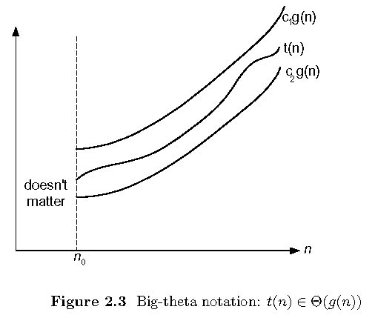

Slide 33
Example
(½)n(n − 1) ∈ Θ(n²):
Proving the right inequality (the upper bound):
(½)n(n − 1) = (½)n² - (½)n ≤ (½)n² foralln≥0.
Proving the left inequality (the lower bound):
(½)n(n − 1) = (½)n² - (½)n ≥ (½)n² - (½)n(½)n = (1/4)n² for all n ≥ 2
So c₂ = 1/4 , c₁ = 1/2 , and n₀ = 2.

Slide 34
Properties of asymptotic order of growth
f(n) ∈ O(f(n))
f(n) ∈ O(g(n)) iff g(n) ∈Ω(f(n))
If f (n) ∈ O(g (n)) and g(n) ∈ O(h(n)) , then f(n) ∈ O(h(n))
If f₁(n) ∈ O(g₁(n)) and f₂(n) ∈ O(g₂(n)) , then f₁(n) + f₂(n) ∈ O(max{g₁(n), g₂(n)})
See next slide for proof

Slide 35
Proof
See page 56.

Slide 36
Establishing Order of Growth
See slides 16, 17, 18, and 19 of textbook slide deck.

Slide 37
Note of Caution about Asymptotic Efficiency
Classifying algorithms by their asymptotic efficiency leaves open the possibility of an algorithm in a worse efficiency class running faster than an algorithm in a better efficiency class for inputs of realistic sizes.
Example: Assuming n³ and 10⁶n² are running times of algorithms, the cubic algorithm will outperform the quadratic algorithm unless n exceeds 10⁶.
A few such anomalies are indeed known.
Fortunately, multiplicative constants usually do not differ that drastically.

Slide 38
General Plan for Analyzing the Time Efficiency of Nonrecursive Algorithms
Decide on a parameter (or parameters) indicating an input’s size.
Identify the algorithm’s basic operation. (As a rule, it is located in the inner-most loop.)
Check whether the number of times the basic operation is executed depends only on the size of an input. If it also depends on some additional property, the worst-case, average-case, and, if necessary, best-case efficiencies have to be investigated separately.
Set up a sum expressing the number of times the algorithm’s basic operation is executed.
Using standard formulas and rules of sum manipulation, either find a closed-form formula for the count or, at the very least, establish its order of growth.

Slide 39
Useful summation formulas and rules
See slide 21 of textbook slide deck
See Appendix A of textbook

Slide 40
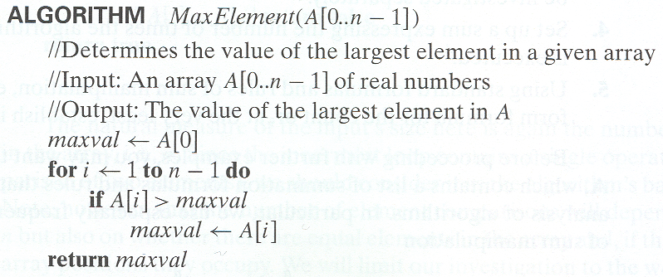
Example 1: Maximum element

Slide 41
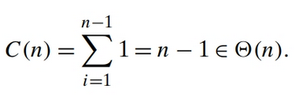
Analysis
Input Size: n
Basic Operation: Comparison – Why not assignment?
The number of comparisons will be the same for all arrays of size n; therefore, in terms of this metric, there is no need to distinguish among the worst, average, and best cases

Slide 42
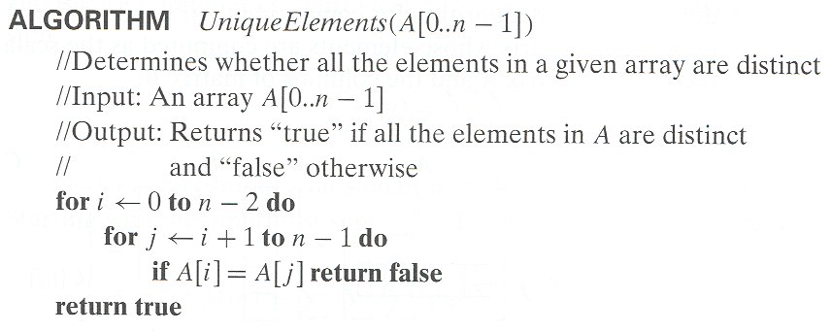
Example 2: Element uniqueness problem

Slide 43
Analysis
Input Size: n
Basic Operation: Comparison
The number of element comparisons depends not only on n but also on whether there are equal elements in the array and, if there are, which array positions they occupy. Worst Case:

Slide 44
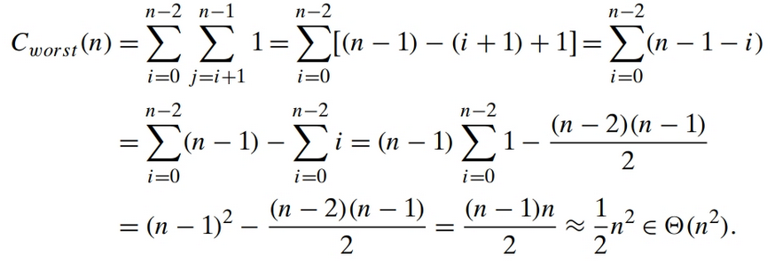
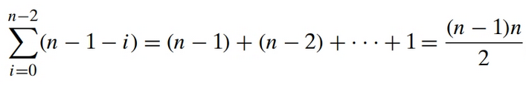

Analysis continued
Longer way:
Shorter way: =

Slide 45
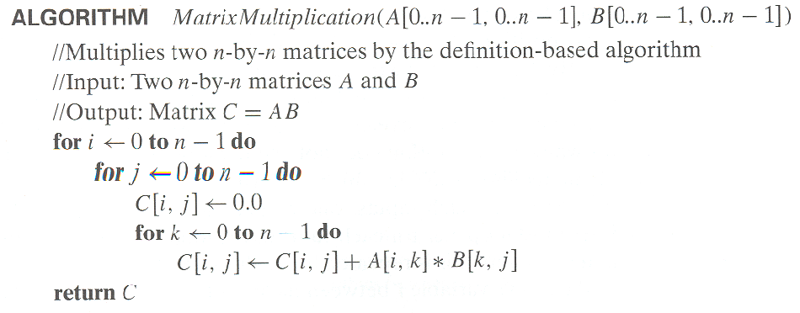
Example 3: Matrix multiplication

Slide 46
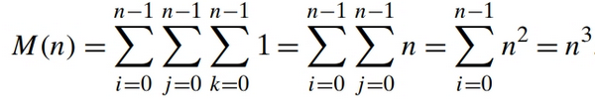
Analysis
Input Size: n
Basic Operation: Multiplication
Since this count depends only on the size of the input matrices, we do not have to investigate the worst-case, average-case, and best-case efficiencies separately.

Slide 47
Analysis
Easier Way to analyze this algorithm:
There are n rows and n columns in an n by n matrix.
Multiplication of two n by n matrices is the result of the dot producting of each row into each column (n * n = n²) n times (n² * n = n³).

Slide 48

Running Time of Algorithm on a Computer
c_{m} is the time of one multiplication on the machine in question.
More accurate estimate if time spent on the additions is accounted for as well:

Slide 49
Example 4: Gaussian elimination
Algorithm GaussianElimination(A[0..n-1,0..n])
//Implements Gaussian elimination of an n-by-(n+1) matrix A
for i ← 0 to n - 2 do for j ← i + 1 to n - 1 do for k ← i to n do
A[j,k] ← A[j,k] - A[i,k] ∗ A[j,i] / A[i,i]
Find the efficiency class and a constant factor improvement.

Slide 50


Analysis – In Homework ☺
Input Size: n
Basic Operation: Division
Since this count depends only on the size of the input matrices, we do not have to investigate the worst-case, average-case, and best-case efficiencies separately.

Slide 51
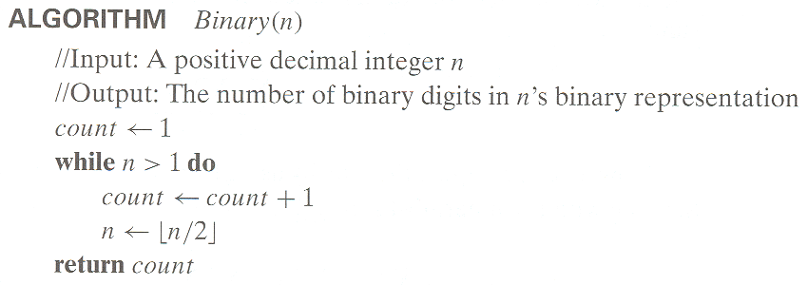
Example 5: Counting binary digits
Cannot be investigated the way the previous examples are.

Slide 52
Analysis
Input Size: n
Basic Operation: Comparison (While loop condition) – Why?
The number of comparisons will be the same for all arrays of size n; therefore, in terms of this metric, there is no need to distinguish among the worst, average, and best cases
The loop variable takes on only a few values between its lower and upper limits; therefore, we have to use an alternative way of computing the number of times the loop is executed.
Since the value of n is about halved on each repetition of the loop, the answer should be about log₂ n. The exact formula for the number of times the comparison n > 1 will be executed is actually ⌊log₂ n⌋ + 1 – the number of bits in the binary representation of n.

Slide 53
Mathematical Analysis of Recursive Algorithms
Decide on a parameter (or parameters) indicating an input’s size.
Identify the algorithm’s basic operation.
Check whether the number of times the basic operation is executed can vary on different inputs of the same size; if it can, the worst-case, average-case, and best-case efficiencies must be investigated separately.
Set up a recurrence relation, with an appropriate initial condition, for the number of times the basic operation is executed.
Solve the recurrence or, at least, ascertain the order of growth of its solution.

Slide 54
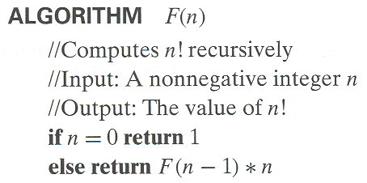
Example 1: Recursive evaluation of n!
Definition: n ! = 1 ⋅ 2 ⋅ … ⋅ (n-1) ⋅ n for n ≥ 1 and 0! = 1
Recursive definition of n!: F(n) = F(n-1) ⋅ n for n ≥ 1 and F(0) = 1
Input Size: n
Basic operation: Multiplication
Recurrence relation:
M(n) = M(n – 1) + 1 for n > 0
to compute to multiply
F(n – 1) F(n – 1) by n

Slide 55
Solving recurrence for number of multiplications
M(n) = M(n - 1) + 1, M(0) = 0

Slide 56
Example 2: The Tower of Hanoi Puzzle

Slide 57
Example 2: The Tower of Hanoi Puzzle
Recurrence for number of moves:

Slide 58
Solving recurrence for number of moves
M(n) = 2M(n-1) + 1, M(1) = 1

Slide 59
Recursion Tree
A Recursion Tree is a visualization of what happens when a recurrence is iterated.
When a recursive algorithm makes more than a single call to itself, it can be useful for analysis purposes to construct a tree of its recursive calls.
In this tree, nodes correspond to recursive calls, and we can label them with the value of the parameter (or parameters) of the calls.
By counting the number of nodes in the tree, we can get the total number of calls made by the algorithm

Slide 60
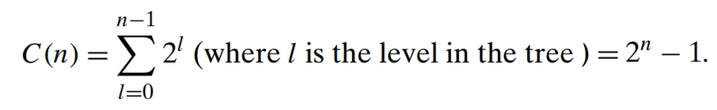
Tree of calls for the Tower of Hanoi Puzzle

Slide 61
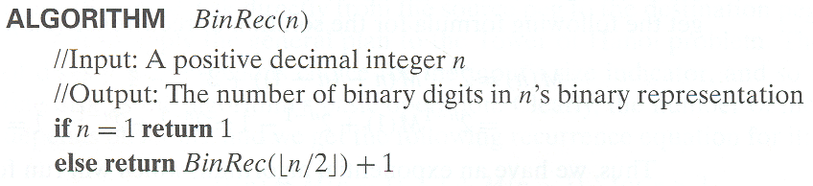
Example 3: Counting #bits

Slide 62
Analysis
The number of additions made in computing BinRec(⌊n/2⌋) is A(⌊n/2⌋), plus one more addition is made by the algorithm to increase the returned value by 1. This leads to the recurrence: A(n) = A(⌊n/2⌋) + 1 for n > 1.
Since the recursive calls end when n is equal to 1 and there are no additions made then, the initial condition is: A(1) = 0.
The presence of ⌊n/2⌋ in the function’s argument makes the method of back-ward substitutions stumble on values of n that are not powers of 2.

Slide 63
So what do we do?
The standard approach to solving such a recurrence is to solve it only for n = 2^{k} and then take advantage of the theorem called the smoothness rule which claims that under very broad assumptions the order of growth observed for n = 2^{k} gives a correct answer about the order of growth for all values of n.

Slide 64
Solution

Slide 65
General Plan for the Empirical Analysis of Algorithm Time Efficiency
Understand the experiment’s purpose.
Decide on the efficiency metric M to be measured and the measurement unit(an operation count vs. a time unit).
Decide on characteristics of the input sample (its range, size, and so on).
Prepare a program implementing the algorithm (or algorithms) for the experimentation.
Generate a sample of inputs.
Run the algorithm (or algorithms) on the sample’s inputs and record the data observed.
Analyze the data obtained.

Slide 66
Ways to measure time efficiency:
Insert a counter (or counters) into a program implementing the algorithm to count the number of times the algorithm’s basic operation is executed.
Time the program implementing the algorithm
Use a system’s command, such as the time command in UNIX.
By asking for the system time right before the fragment’s start (t_{start} ) and just after its completion (t_{finish}), and then computing the difference between the two(t_{finish} − t_{start}).
In C and C++, you can use the clock() function and in Java, the currentTimeMillis() method of the System class.

Slide 67
Problems and Possible Solutions
A system’s time is typically not very accurate, and you might get somewhat different results on repeated runs of the same program on the same inputs.
Remedy: make several such measurements and then take their average (or the median) as the sample’s observation point.
Given the high speed of modern computers, the running time may fail to register at all and be reported as zero.
Remedy: run the program in an extra loop many times, measure the total running time, and then divide it by the number of the loop’s repetitions.
On a computer running under a time-sharing system such as UNIX, the reported time may include the time spent by the CPU on other programs as well as context switching.
Remedy: ask the system for the time devoted to your program. (For example, in UNIX, this time is called the “user time,” and it is automatically provided by the time command.)

Slide 68
Profiling
Measuring time spent on different segments of a program is called profiling.
Why should we profile our program?
Profiling can pinpoint a bottleneck in the program’s performance that can be missed by an abstract deliberation about the algorithm’s basic operation.

Slide 69
Input Sample
Whether you decide to measure the efficiency by basic operation counting or by time clocking, you will need to decide on a sample of inputs for the experiment:
It is sensible to start with a relatively small sample and increase it later if necessary
The range of instance sizes is typically neither trivially small nor excessively large, and
A procedure for generating instances in the range
The instance sizes can either adhere to some pattern (e.g., 1000, 2000, 3000, …) or
generated randomly within the range chosen but make sure it includes even, odd, prime, single digit, double digit, triple digit, etc. numbers

Slide 70
Data Representation
The empirical data obtained as the result of an experiment need to be recorded and then presented for analysis. Data can be presented
numerically in a table or
graphically in a scatterplot, i.e., by points in a Cartesian coordinate system.
Both methods have their unique strengths and weaknesses:
The principal advantage of tabulated data lies in the opportunity to manipulate it easily
The form of a scatterplot helps in ascertaining the algorithm’s probable efficiency class

Slide 71
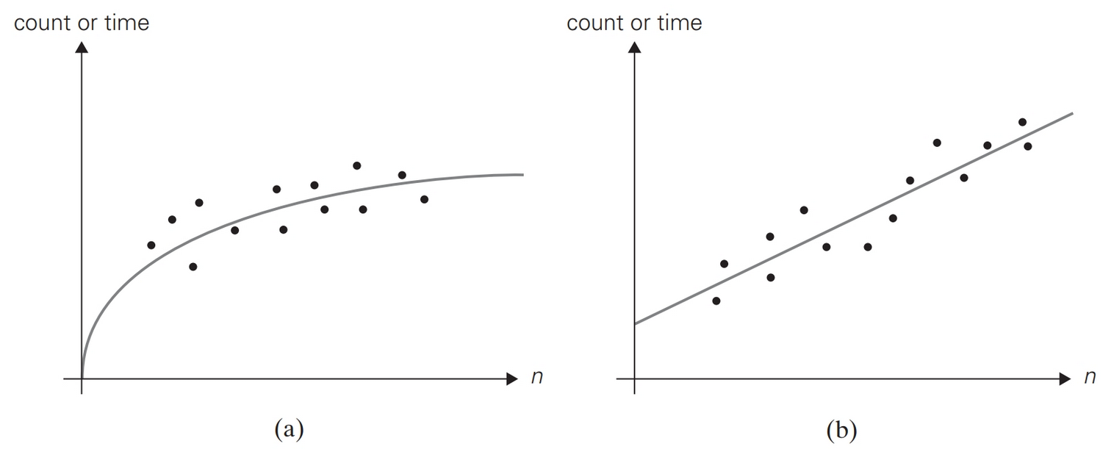
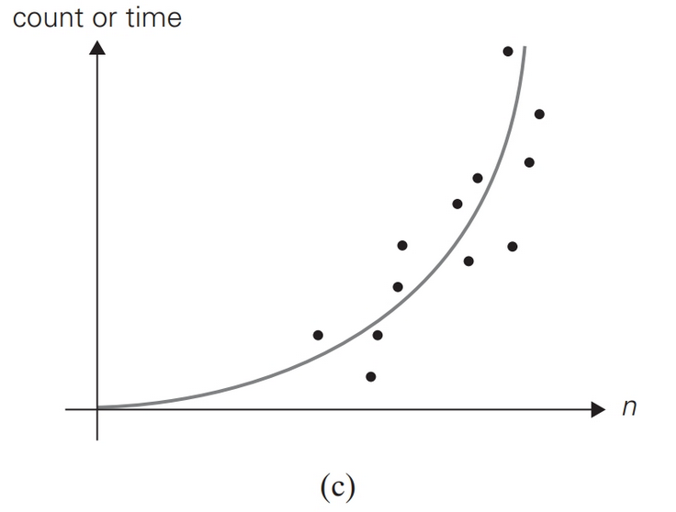
Scatter Plot Examples
Logarithmic. Linear. Quadratic.

Slide 72
An application of the Empirical Analysis
Prediction of the algorithm’s performance on an instance not included in the experiment sample.
For example, if we observe that the ratios M(n)/g(n) are close to some constant c for the sample instances, it could be sensible to approximate M(n) by the product cg(n) for other instances, too.
This approach should be used with values within the sample range (interpolation) and not for values of n outside the sample range (extrapolation)

Slide 73
Algorithm Visualization
The use of images to convey some useful information about algorithms.
That information can be a visual illustration of an algorithm’s operation, of its performance on different kinds of inputs, or of its execution speed versus that of other algorithms for the same problem.
There are two principal variations of algorithm visualization:
Static algorithm visualization
Dynamic algorithm visualization, also called algorithm animation

